Slide 1
Blockchain for Provenance in a Repo to Auction System
Mason Harlan

Slide 2
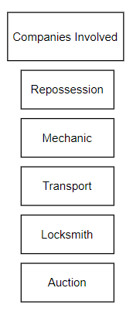
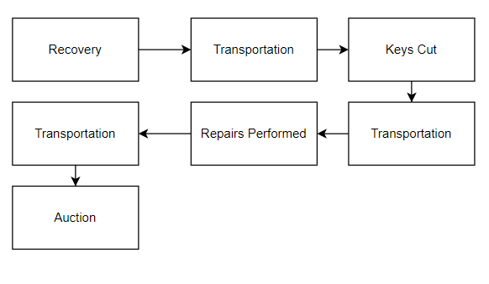
Market Overview

Slide 3
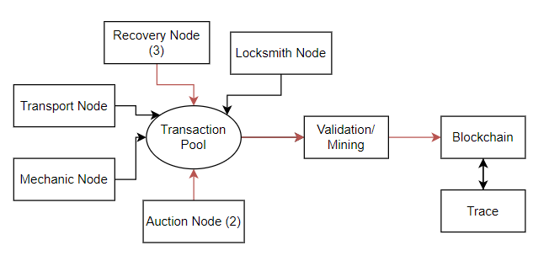
System Overview

Slide 4
Github & Video
https://drive.google.com/file/d/1Z__7-Lm9RNVRe18jHAfEaTe0PbP66QOn/view?usp=sharing
https://github.com/mgharlan/project491

